Slide 1

SOFTWARE ENGINEERING ASSIGNMENT
ARCHITECTURAL PATTERN

Slide 2

ARCHITECTURAL PATTERN:
There are various ways to organize the components in software architecture. And the different predefined organization of components in software architectures are known as software architecture patterns
In each pattern, the components are organized differently for solving a specific problem in software architectures

Slide 3
TYPES OF ARCHITECTURAL PATTERN:
There are five types of architectural pattern they are:
Layered Pattern
Client-Server Pattern
Event-Driven Pattern
Microkernel Pattern
Microservices Pattern

Slide 4
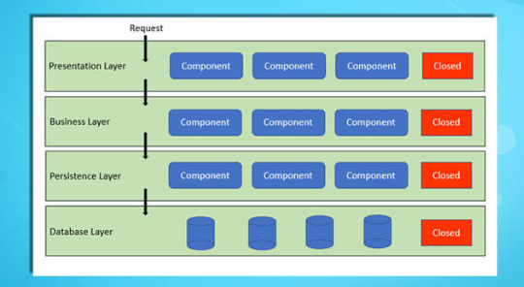
LAYERED PATTERN:
In this pattern the components are separated into layers of subtasks and they are arranged one above another.
Each layer has unique tasks to do and all the layers are independent of one another.
It is the most commonly used pattern for designing the majority of software. This layer is also known as ‘N-tier architecture’. Basically, this pattern has 4 layers.
Presentation layer
Business layer
Application layer
Data layer

Slide 5
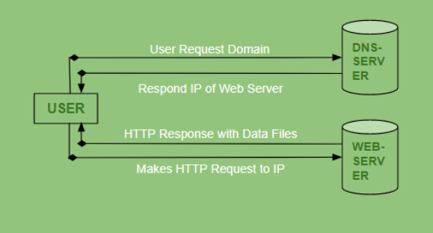
CILENT-SERVER PATTERN:
The client-server pattern has two major entities. They are a server and multiple clients.
Here the server has resources such as data,files or services and a client requests the server for a particular resource. Then the server processes the request and responds back accordingly.
Examples of software developed in this pattern:
Email.
WWW.
File sharing apps.

Slide 6
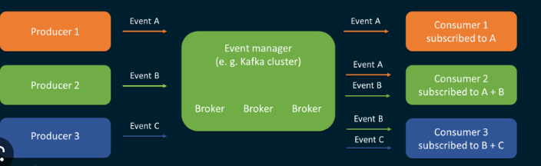
EVENT-DRIVEN PATTERN:
Event-Driven Architecture is an agile approach in which services (operations) of the software are triggered by events.
When a user takes action in the application built using the EDA approach, a state change happens and a reaction is generated that is called an event.
Eg: A new user fills the signup form and clicks the signup button on Facebook and then a FB account is created for him, which is an event.
Ideal for:
Building websites with JavaScript
e-commerce websites in general.

Slide 7
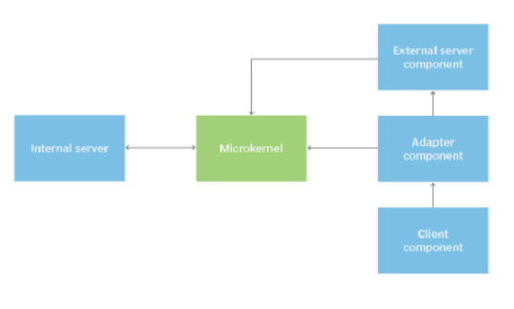
MICROKERNAL PATTERN:
Microkernel pattern has two major components. They are a core system and plug-in modules.
The core system handles the fundamental and minimal operations of the application.
The plug-in modules handle the extended functionalities (like extra features) and customized processing.
Microkernel pattern is ideal for
Product-based applications
scheduling applications.

Slide 8
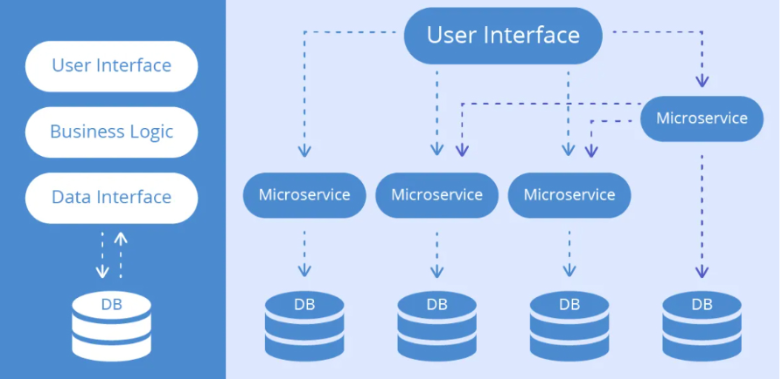
MICROSERVICES PATTERN:
The collection of small services that are combined to form the actual application is the concept of microservices pattern. Instead of building a bigger application, small programs are built for every service (function) of an application independently. And those small programs are bundled together to be a full-fledged application.
Example
Netflix is one of the most popular examples
of software built-in microservices architecture.
This pattern is most suitable for websites and
web apps having small components.

Slide 9
Thank you
BY:
SRE SIDHARTTH S
21BCS117

